Slide 1
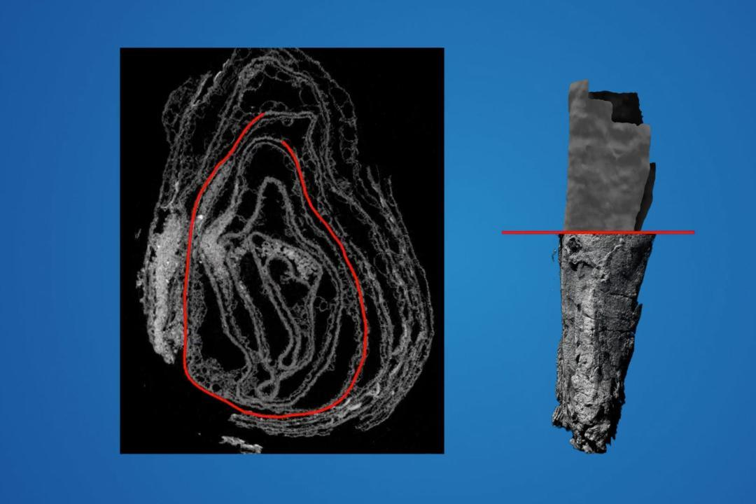

Exploring Virtual Unwrapping
Class Bonus Activity - Student Presentations Abubakar Waziri -4220056

Slide 2
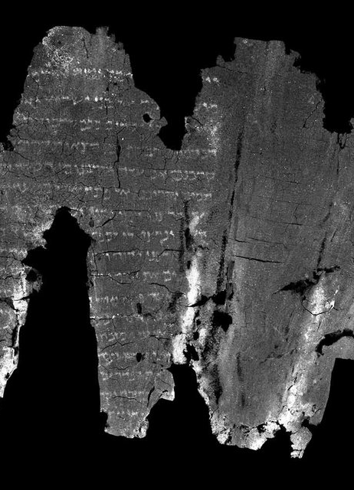
Introduction to Virtual Unwrapping
Definition and Concept: Virtual unwrapping is a digital preservation technique that uses non-invasive imaging methods (e.g., CT or MRI scans) to reveal the contents of fragile or damaged artifacts. This method reconstructs internal structures digitally, avoiding physical manipulation that might cause further damage.
Significance: Virtual unwrapping is crucial for preserving cultural heritage by providing access to historical information that would otherwise remain inaccessible. It allows researchers to study ancient manuscripts, scrolls, and artifacts without risking their destruction.
Historical Background: The origins of virtual unwrapping can be traced to advancements in imaging technology and computational algorithms. Key breakthroughs include its application to the En-Gedi Scroll, where biblical texts were digitally unrolled and read for the first time in centuries.

Slide 3
Technical Process and Tools
Imaging Techniques:
CT (Computed Tomography): Captures detailed, 3D internal structures, ideal for studying rolled or layered artifacts.
MRI (Magnetic Resonance Imaging): Effective for materials that respond well to magnetic fields, such as certain organic substances.
Data Segmentation:
The process of isolating specific layers within the artifact, such as separating the rolled layers of a scroll or folded pages of a manuscript. Algorithms play a key role in identifying and extracting these layers.
Flattening and Reconstruction:
After segmentation, the extracted layers are digitally flattened or unrolled using specialized software to create readable, 2D representations.
Tools and Software: Common tools include: • 3D modeling software for reconstruction. • Machine learning algorithms for enhanced pattern recognition. • Image processing tools like MATLAB or custom-built software tailored for virtual unwrapping.

Slide 4
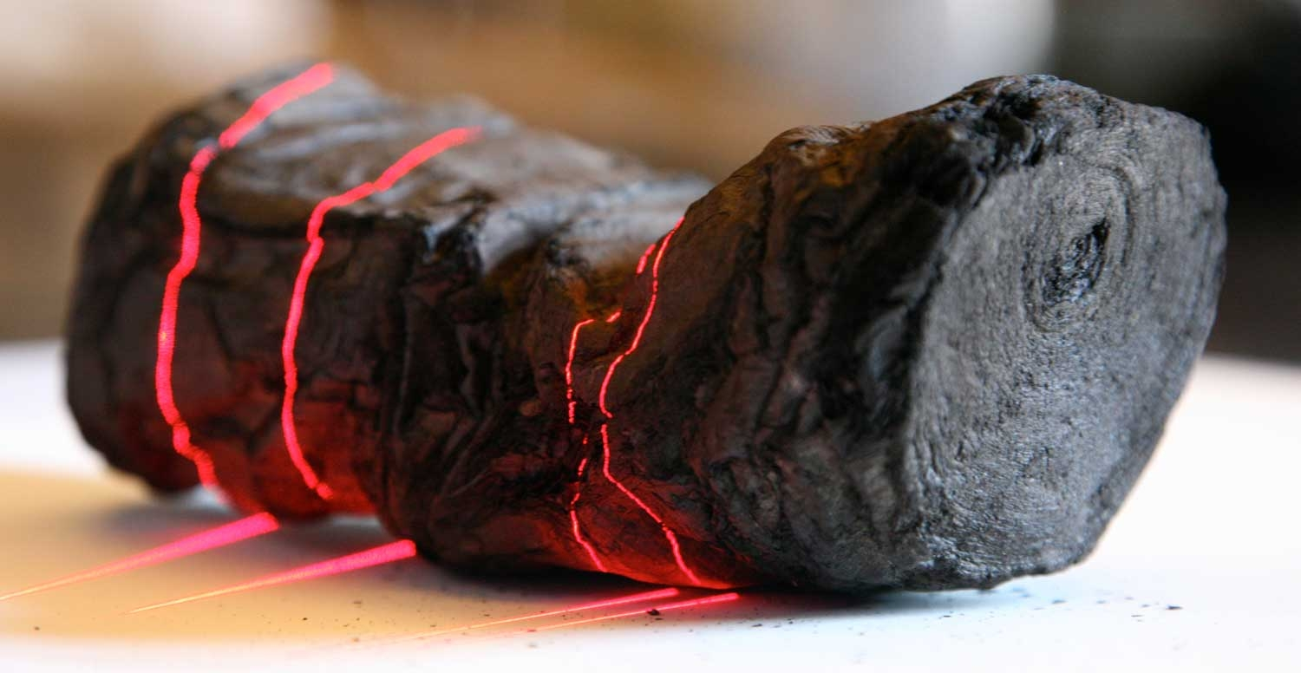
Applications in Computer Vision

Slide 5
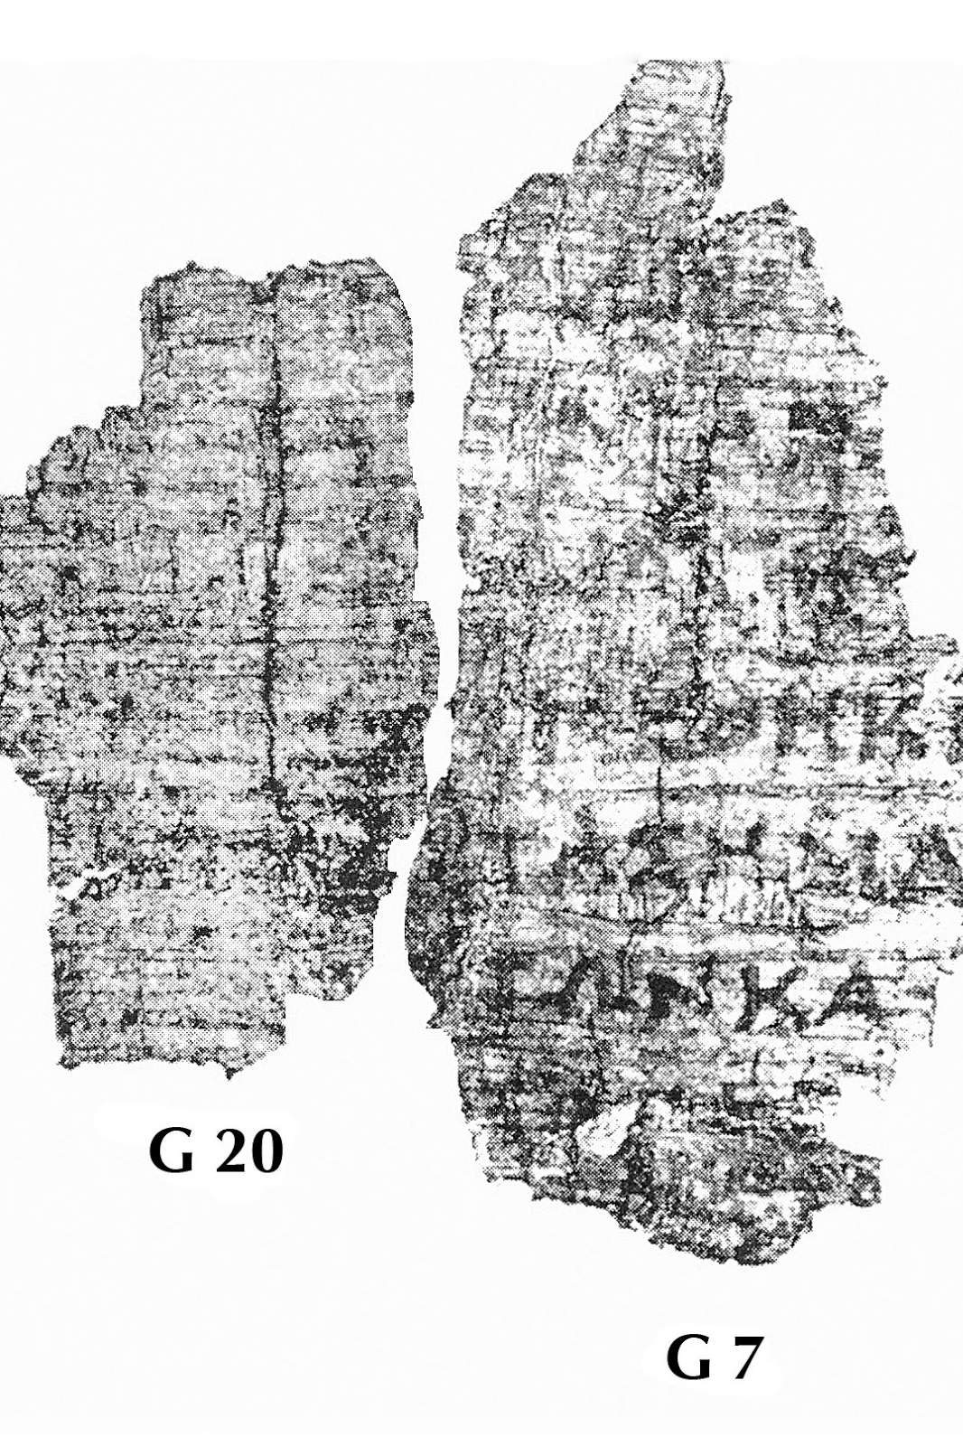
Image Segmentation and Layer Reconstruction
Role: Separating different layers of an artifact (e.g., rolled scrolls or folded parchments).
Applications: Used in analyzing and isolating text, patterns, or structures in multi-layered objects for easier interpretation and study.

Slide 6
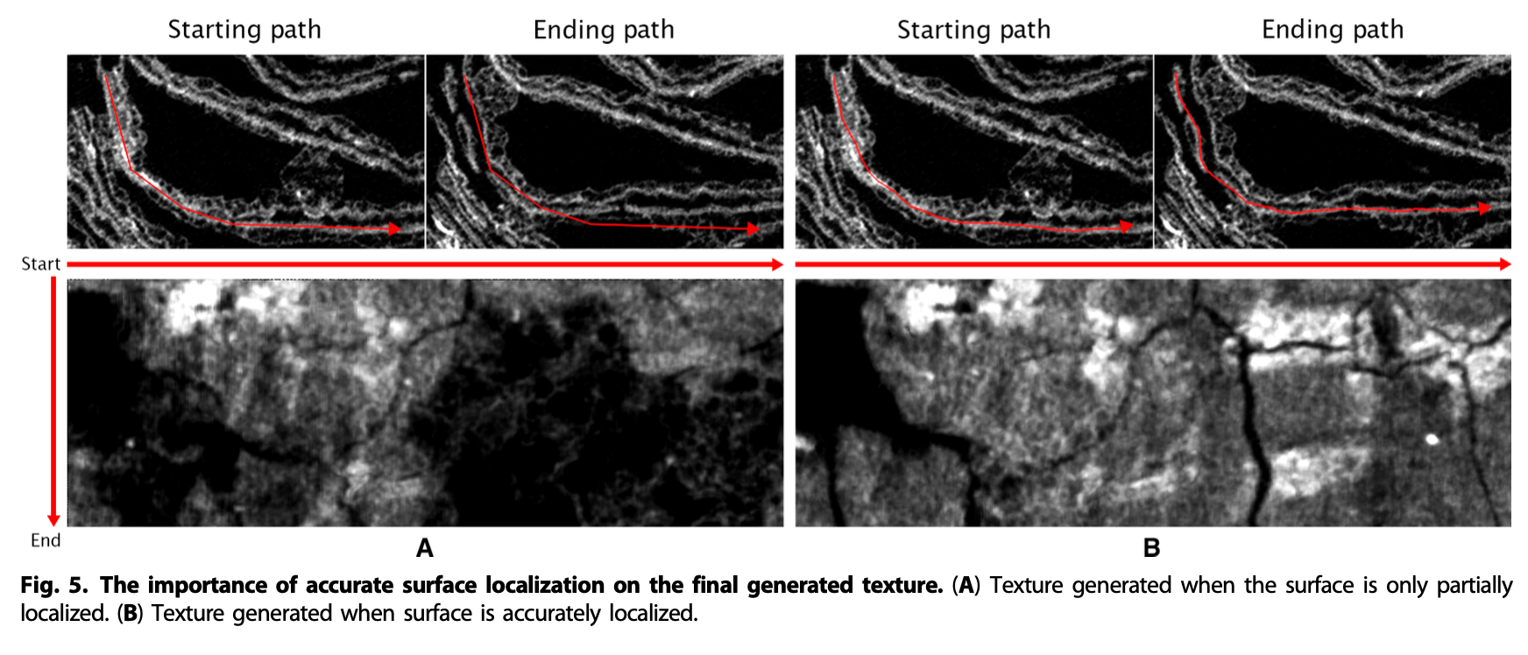
Surface Localization

Slide 7
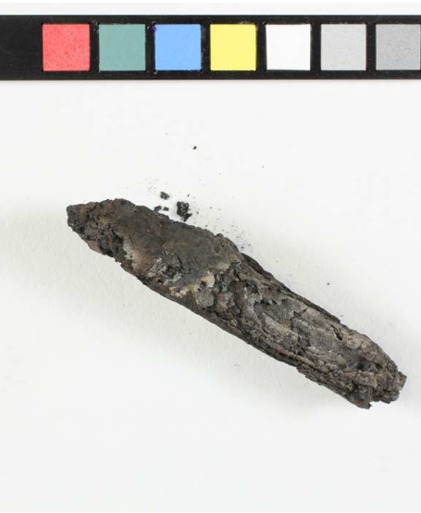
Pattern Recognition and Text Recovery
Role: Identifying and reconstructing damaged or faded text and patterns using advanced recognition algorithms.
Applications: Digitizing and restoring historical scripts or inscriptions, even in degraded or incomplete states.

Slide 8
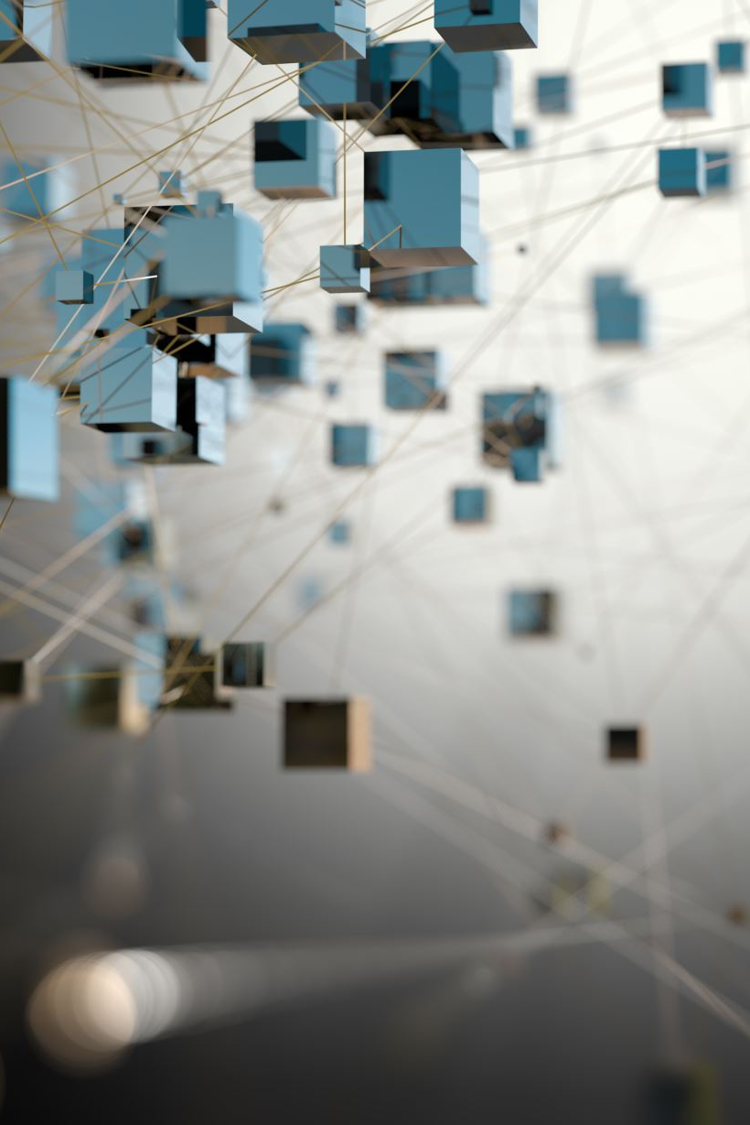
3D Modeling and Visualization
Role: Reconstructing the artifact’s 3D structure digitally to create an accurate representation.
Applications: Enables researchers to interact with virtual models or integrate artifacts into AR/VR platforms for immersive experiences.

Slide 9
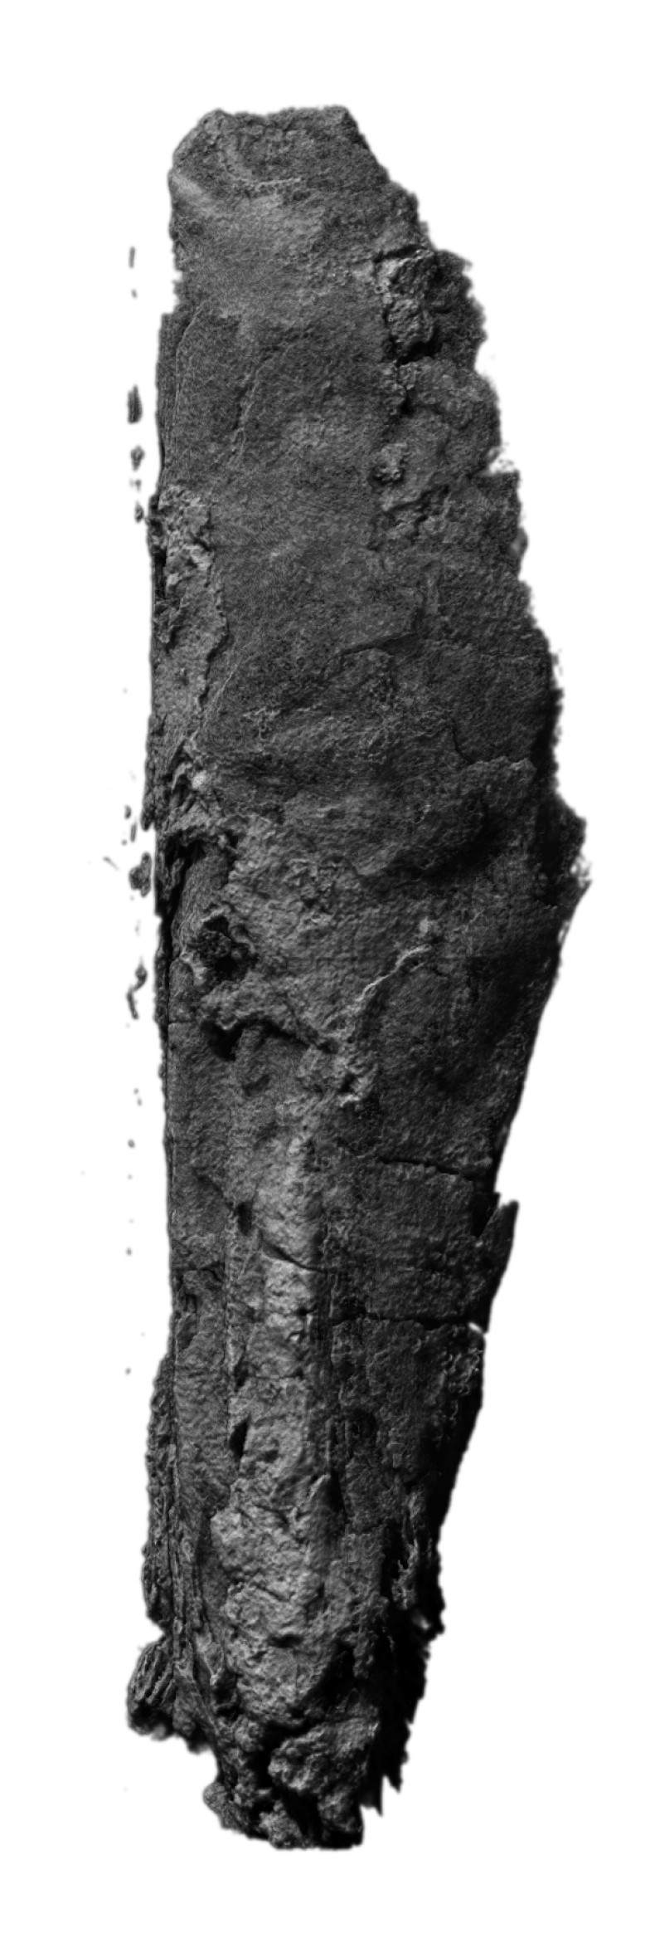
Image Enhancement and Super-Resolution
Role: Enhancing the clarity and resolution of scanned images to reveal finer details.
Applications: Highlights subtle features like faded ink or material textures for better analysis and preservation.

Slide 10
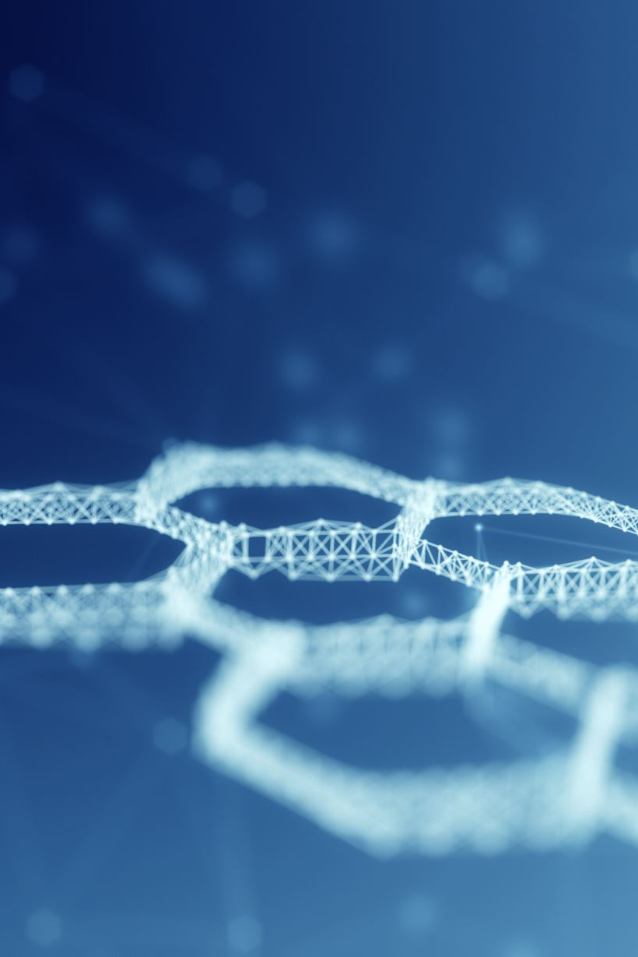
Machine Learning for Automation
Role: Automating artifact analysis by training AI models on large datasets.
Applications: Improves accuracy in layer segmentation, pattern recognition, and text reconstruction, reducing manual intervention.

Slide 11
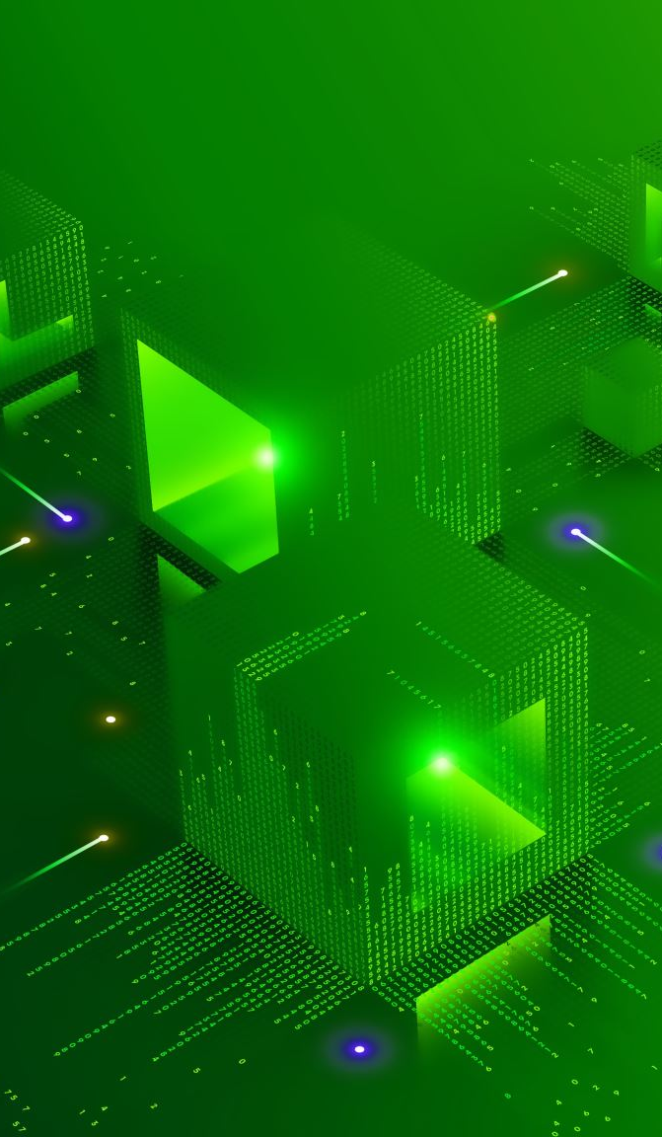
Virtual Unwrapping Algorithms
Segmentation Algorithms: Use AI to identify and isolate distinct layers within an artifact digitally. These algorithms are key for separating tightly packed or overlapping layers.
Pattern Recognition: Advanced techniques help reconstruct degraded text or images by recognizing patterns and filling in missing information.
Machine Learning: Machine learning models improve accuracy and efficiency by training on diverse artifact data, allowing them to handle variations in texture, material, and condition.

Slide 12
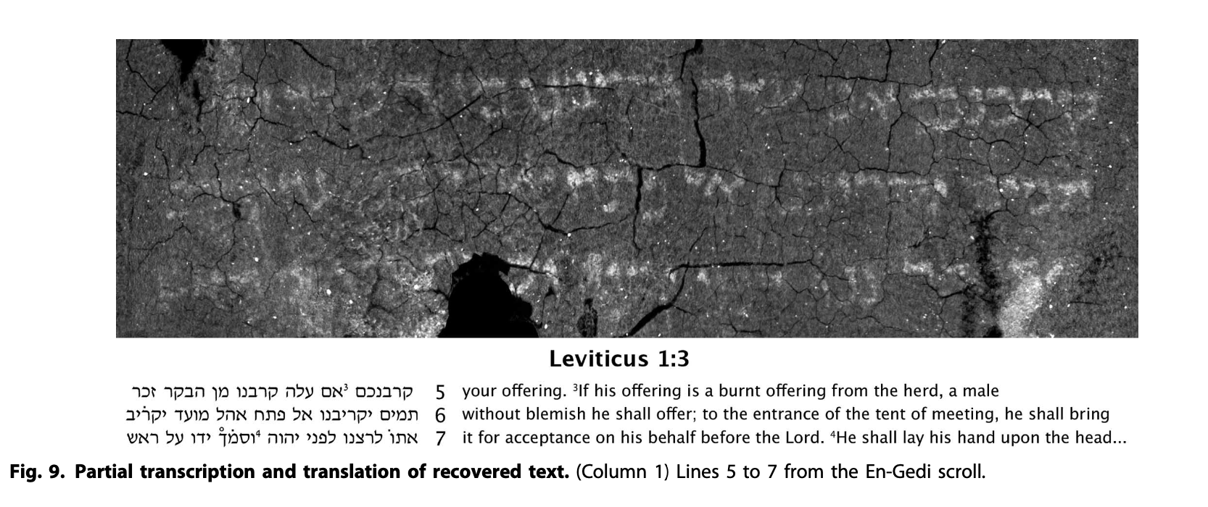
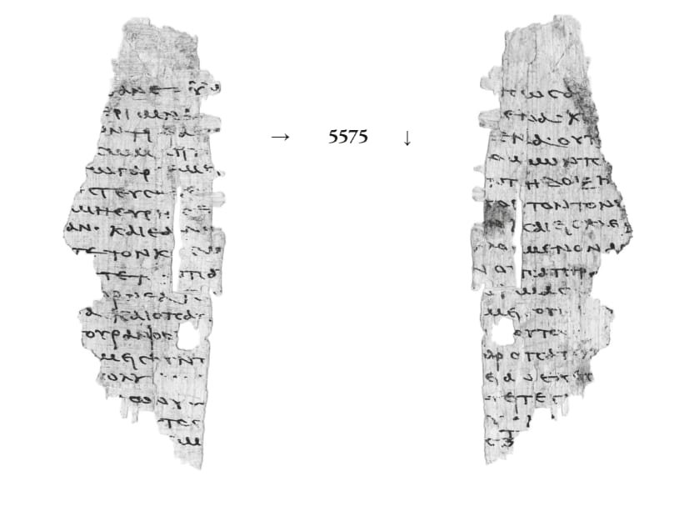

Slide 13
Advantages and Challenges
Advantages: • Non-invasive and non-destructive, preserving artifact integrity. • Safe study of fragile items without physical risk. • Access to previously inaccessible or rare artifacts, expanding research possibilities.
Challenges: • High costs associated with imaging equipment and computational resources. • Specialized expertise required to interpret segmented data. • Limited access to technology in underfunded institutions or regions.

Slide 14
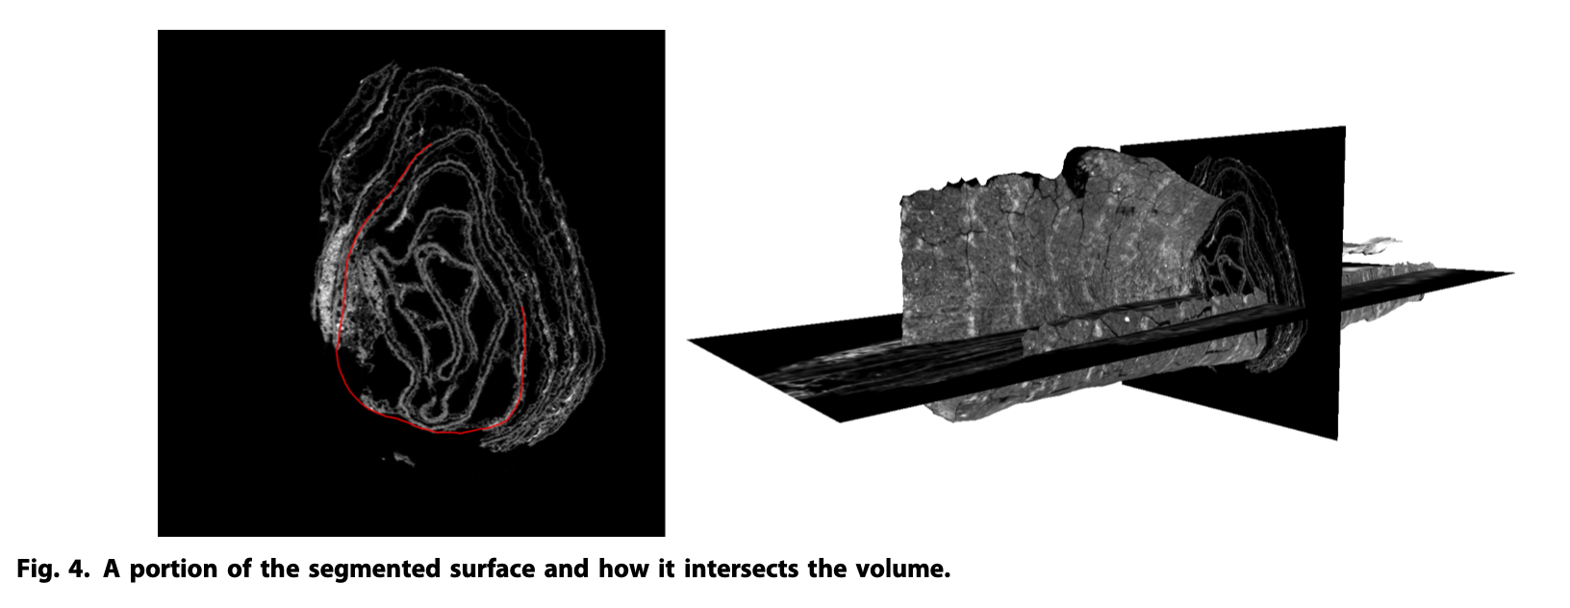
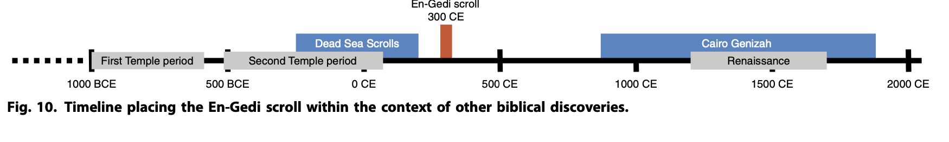
En-Gedi Scroll

Slide 15
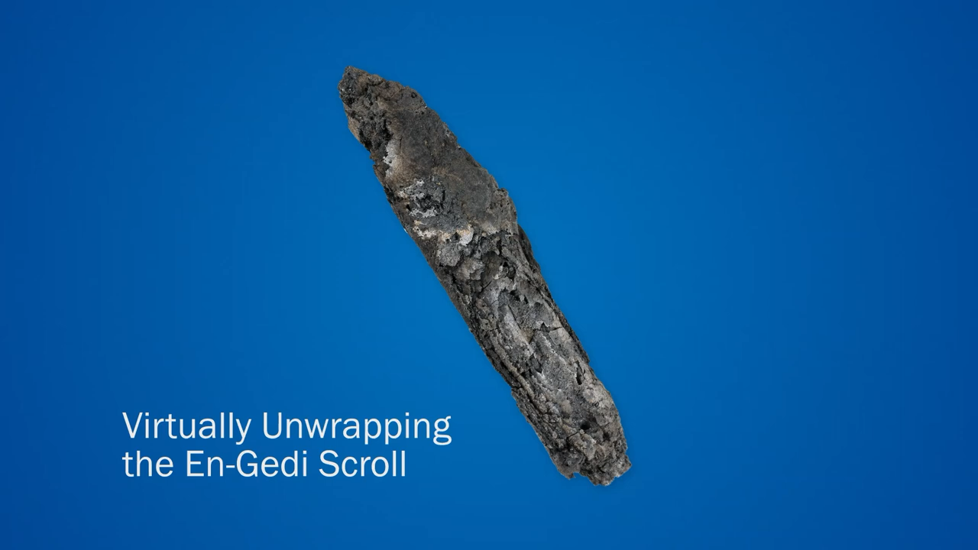
demo

Slide 16
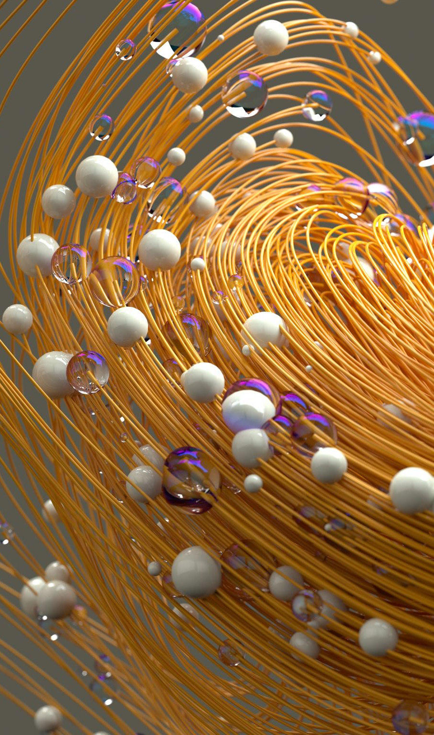
Future Potential and Innovations
Advances in AI and Imaging: Continued development in AI could make segmentation and reconstruction more accurate and accessible. Faster algorithms may reduce processing times significantly.
Broader Applications: • Application in medical imaging to study historical remains or diagnose damage in cultural artifacts. • Creation of 3D replicas or AR experiences for educational and museum purposes, allowing virtual exploration of artifacts.
Global Collaboration: Efforts to develop open-source tools and foster international collaboration could democratize access to virtual unwrapping technologies, benefiting researchers worldwide.

